Slide 1
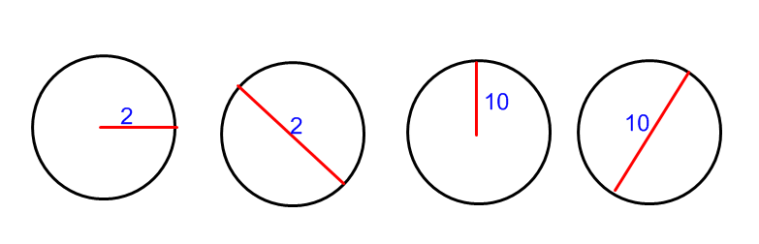
Warm-up:
Determine the circumference of the following circles in terms of π.
HW: p367-368 (5 – 10 , 15 -18 , 25, 27, 33 – 36 , 43 – 61 odd, 71, 73)

Slide 2
4.1 Radian and Degree Measure
Objective:
Terminology used to describe angles
Find Coterminal Angles
Changing Degrees to Radians
Changing Radians to Degrees
Find Arc Length

Slide 3
Definition of an angle
An angle is made from two rays with a common initial point called the vertex.
Standard Position
Vertex at origin
The initial side of an angle in standard position is always located on the positive x-axis.

Slide 4
Positive and negative angles
When sketching angles, always use an arrow to show direction.

Slide 5
Measuring Angles
The measure of an angle is determined by the amount of rotation from the initial side to the terminal side.
There are two common ways to measure angles, in degrees and in radians.
We’ll start with degrees, denoted by the symbol º.
One degree (1º) is equivalent to a rotation of of one revolution.

Slide 6
Classifying Angles
Angles are often classified according to the quadrant in which their terminal sides lie.
Ex1: Name the quadrant in which each angle lies.
50º
208º II I
-75º
III IV
Quadrant 1
Quadrant 3
Quadrant 4

Slide 7
Classifying Angles
Standard position angles that have their terminal side on one of the axes are called quadrantal angles.
For example, 0º, 90º, 180º, 270º, 360º, … are quadrantal angles.

Slide 8
Coterminal Angles
A set of angles that have the same initial and terminal sides are coterminal.
Angles α and β are coterminal.

Slide 9
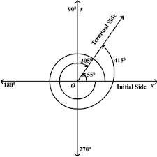
Example of Finding Coterminal Angles
You can find an angle that is coterminal to a given angle θ by adding or subtracting multiples of 360º.
Ex 2: Find one positive and one negative angle that are coterminal to 112º.
For a positive coterminal angle, add 360º : 112º + 360º = 472º
For a negative coterminal angle, subtract 360º: 112º - 360º = -248º

Slide 10
Ex 3. Find one positive and one negative angle that is coterminal with the angle θ = 30° in standard position.
30º + 360º = 390º
30º - 360º = -330º
Ex 4. Find one positive and one negative angle that is coterminal with the angle θ = 372° in standard position.
372º + 360º = 732º
372º - 360º = 12º
12º - 360º = -348º

Slide 11
Radian Measure
A second way to measure angles is in radians.
Definition of Radian:
One radian is the measure of a central angle θ that intercepts arc s equal in length to the radius r of the circle.
In general, for θ radians

Slide 12
Radian Measure➔ one revolution gives

Slide 13
Radian Measure

Slide 14
Radian vs. Degree measurements
360º =
180º =
Changing from degree to radians multiply degrees by
Changing from radians to degree multiply radians by

Slide 15
Ex 5. Convert the degrees to radian measure.
140°
b) -54°

Slide 16
Ex 6. Convert the radians to degrees.
a)
b)

Slide 17
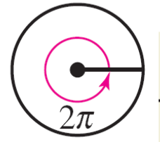
Find the Coterminal Angle
Since is the same location as 0,
it can be added or subtracted from any angle to find a coterminal angle.
Given

Slide 18
Ex 7. Find one positive angle that is coterminal with the angle θ = in standard position.
Ex 8. Find one negative angle that is coterminal with the angle θ = in standard position.

Slide 19
Degree and Radian Form of “Special” Angles
90 ° ⇒
⇐ 135 °
45 ° ⇒
θ
0° ⇒
360 ° ⇒
⇐ 180 °
⇐ 225 °
315 ° ⇒
270 ° ⇒

Slide 20
Degree and Radian Form of “Special” Angles
90 ° ⇒
⇐ 120 °
60 ° ⇒
⇐ 150 °
30 ° ⇒
θ
0° ⇒
360 ° ⇒
⇐ 180 °
⇐ 210 °
330 ° ⇒
⇐ 240 °
300 ° ⇒
270 ° ⇒

Slide 22
How to use radian to find Arc length
In degrees, Arc length (S) would be …
Percent
Circumference
Convert to radians
In radian the equation is
where θ is measured in radians

Slide 23
How to use radian to find Arc length
r = 9, θ = 215º
Changing 215º to radians
Are length S

Slide 24
Find the angle in radians and degree.

Slide 25
Sneedlegrit:
Convert from degrees to radians.
1. 54°
Convert from radians to degrees.
2.
HW: p367-368 (5 – 10 , 15 -18 , 25, 27, 33 – 36 , 43 – 61 odd, 71, 73)

