Slide 1
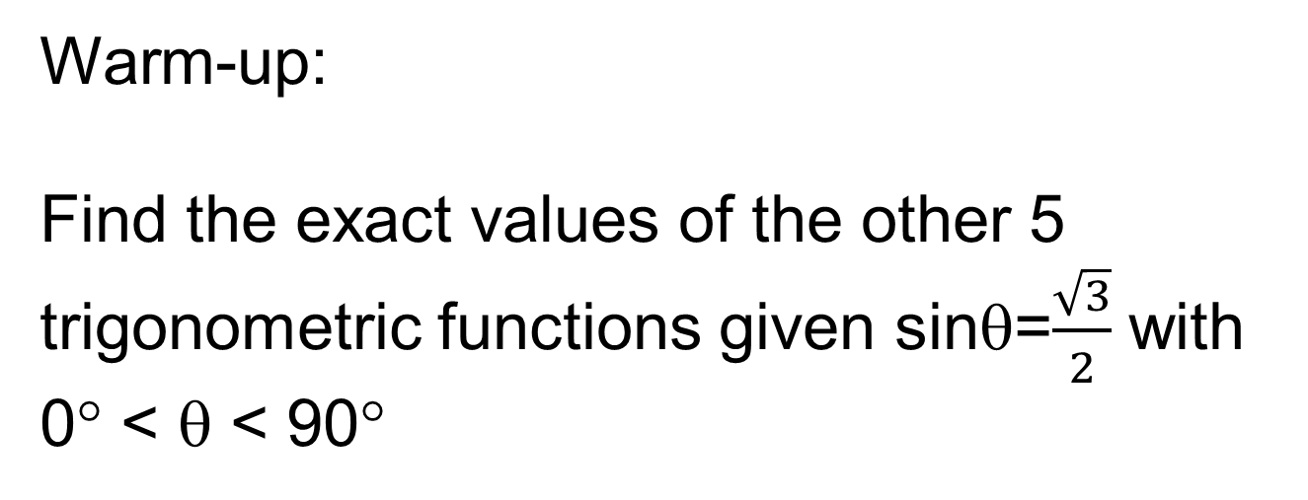
Warm-up:
Find the exact values of the other 5 trigonometric functions given sinθ=$\frac{\sqrt{3}}{2}$ with 0° < θ < 90°
CW: Right Triangle Trig

Slide 2
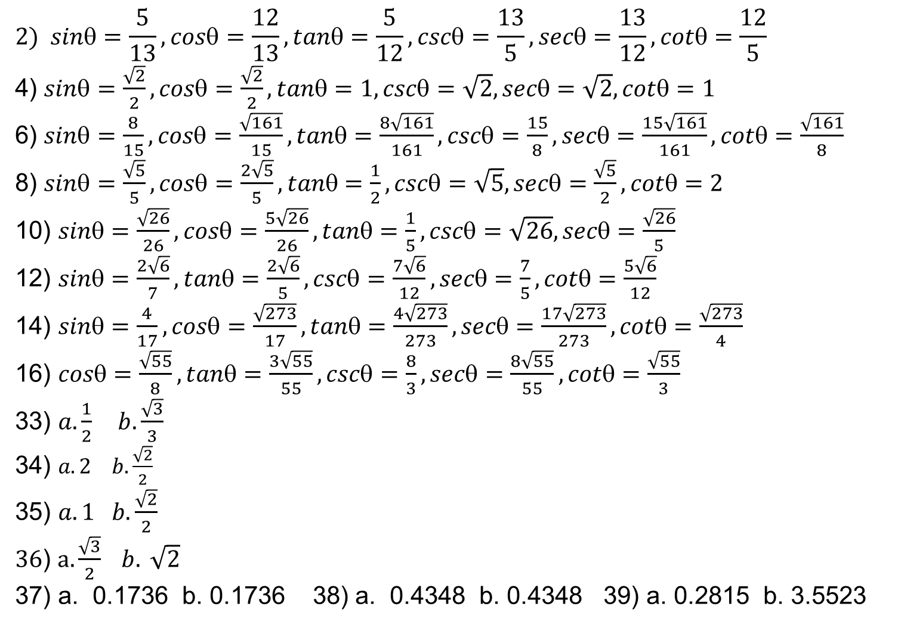
HW Answers: pg.387 (2 – 16 even, 33 – 36, 37 – 39, 47 – 52, 59 – 66)
$$2) sin=\frac{5}{13}, cos=\frac{12}{13}, tan=\frac{5}{12}, csc=\frac{13}{5}, sec=\frac{13}{12}, cot=\frac{12}{5}$$
4) $sin=\frac{\sqrt{2}}{2}, cos=\frac{\sqrt{2}}{2}, tan=1, csc=\sqrt{2}, sec=\sqrt{2}, cot=1$
6) $sin=\frac{8}{15}, cos=\frac{\sqrt{161}}{15}, tan=\frac{8\sqrt{161}}{161}, csc=\frac{15}{8}, sec=\frac{15\sqrt{161}}{161}, cot=\frac{\sqrt{161}}{8}$
8) $sin=\frac{\sqrt{5}}{5}, cos=\frac{2\sqrt{5}}{5}, tan=\frac{1}{2}, csc=\sqrt{5}, sec=\frac{\sqrt{5}}{2}, cot=2$
10) $sin=\frac{\sqrt{26}}{26}, cos=\frac{5\sqrt{26}}{26}, tan=\frac{1}{5}, csc=\sqrt{26}, sec=\frac{\sqrt{26}}{5}$
12) $sin=\frac{2\sqrt{6}}{7}, tan=\frac{2\sqrt{6}}{5}, csc=\frac{7\sqrt{6}}{12}, sec=\frac{7}{5}, cot=\frac{5\sqrt{6}}{12}$
14) $sin=\frac{4}{17}, cos=\frac{\sqrt{273}}{17}, tan=\frac{4\sqrt{273}}{273}, sec=\frac{17\sqrt{273}}{273}, cot=\frac{\sqrt{273}}{4}$
16) $cos=\frac{\sqrt{55}}{8}, tan=\frac{3\sqrt{55}}{55}, csc=\frac{8}{3}, sec=\frac{8\sqrt{55}}{55}, cot=\frac{\sqrt{55}}{3}$
33) $a. \frac{1}{2} b. \frac{\sqrt{3}}{3}$
34) $a. 2 b. \frac{\sqrt{2}}{2}$
35) $a. 1 b. \frac{\sqrt{2}}{2}$
$36$) $a.\frac{\sqrt{3}}{2} b. \sqrt{2}$
37) a. 0.1736 b. 0.1736 38) a. 0.4348 b. 0.4348 39) a. 0.2815 b. 3.5523

Slide 3

$a. 30°= \frac{π}{6} b. 30°= \frac{π}{6}$
$a. 45°= \frac{π}{4} b. 45°= \frac{π}{4}$
$a. 60°= \frac{π}{3} b. 45°= \frac{π}{4}$
$a. 60°= \frac{π}{3} b. 60°= \frac{π}{3}$
$a. 60°= \frac{π}{3} b. 45°= \frac{π}{4}$
$a. 60°= \frac{π}{3} b. 45°= \frac{π}{4}$
59) $\frac{32\sqrt{3}}{3}$
60) $20\sqrt{2}$
23.3
68.7
6.1
96.6
17.25 ft
a. b. 6/3 = h/135 c.270ft
h
6
132
3

Slide 4
Sneedlegrit:
Let θ be an acute angle such that tanθ = 4 Find the other six trigonometric functions.
CW: Right Triangle Trig

