Slide 1
Warm-up:
Given $tanθ=\frac{3}{5}$ find cosθ and θ.
HW: Pg. 399-401(1 – 21 odd 43, 49, 63-68)

Slide 2
Objectives
Evaluate trigonometric functions of any angle
Use reference angles to evaluate trigonometric functions.

Slide 3
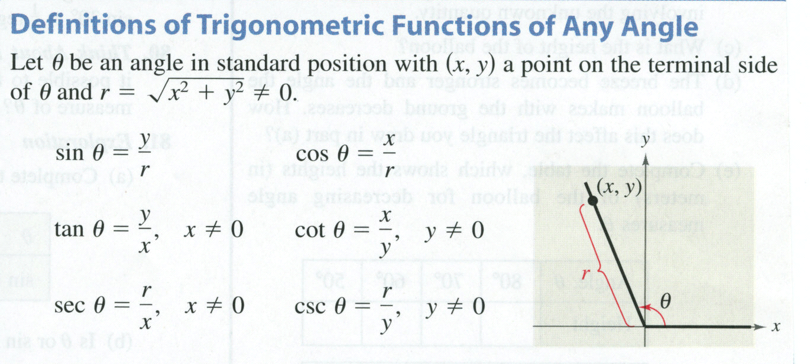
Definitions of trigonometric functions
Syr Cxr Tyx

Slide 4
Find the trig functions using a point on the terminal side
syr cxr tyx
Ex. Find the sine, cosine, and tangent of if (-3,4)
is a point on the terminal side of .
(-3,4)
? =
5
4
-3

Slide 5
Trigonometric function signs
Students
All
All 6 trig functions are positive in quadrant 1
Sin and its reciprocal csc
Take
Calculus
Tan and its reciprocal cot
Cos and its reciprocal sec

Slide 6
Find the quadrant
sinθ > 0; cosθ <0
sinθ < 0; cosθ > 0

Slide 7
Ex. Given and , find
and .
First, determine what quadrant theta lies in.
Where is tan (-) and cos (+)?
IV
4
-5
= ?

Slide 8
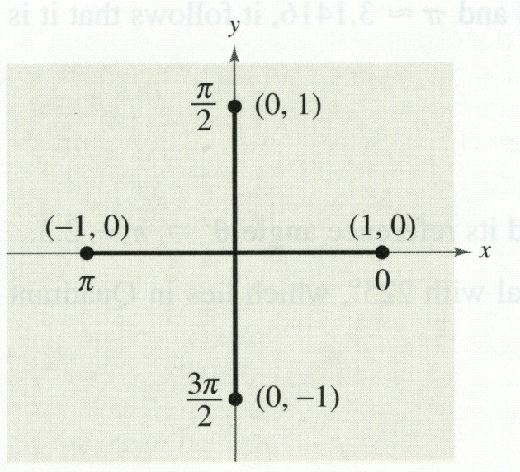
Quadrant angles
Review
x
y
θ | cos θ | sin θ
0
π/2
π
3π/2
2π

Slide 9
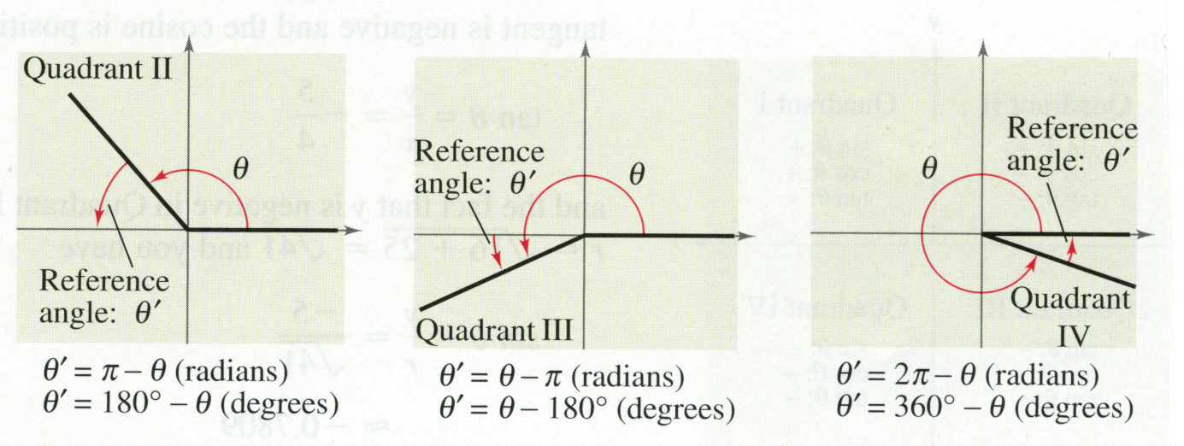
Reference angle
Let θ be an angle in standard position. Its reference angle is the acute angle θ‘ formed by the terminal side of θ and the horizontal axis.
Reference angles are always measured between the x axis and the terminal side of the angle (always +!)

Slide 10
Drawing Reference Angles
Find the reference angle θ', and sketch θ and θ' in standard position.
1) θ = -145°
2)

Slide 11
Finding the Trig functions of any angle
Find the reference angle
Determine the value of the given trig function of the reference angle.
Determine the sign—based on the quadrant of the given (original) angle

Slide 12
Find the trig functions of an angle
Evaluate the sine, cosine, and tangent of the angle without using a calculator.
-405°

Slide 13
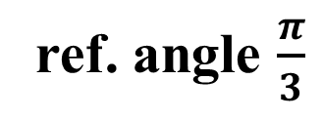

Evaluate:
Also notice: $\frac{π}{3}=60°$
ref. angle $\frac{π}{3}$
Cos (-) in QIII
-1
60°
2

Slide 14
Evaluate:
tan (-210º)
30º ref. angle
Tan (-) in QII
2
1
30°

Slide 15

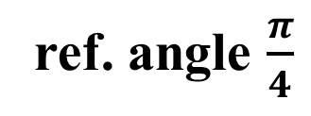
Evaluate:
Also notice: $\frac{π}{4}=45°$
ref. angle $\frac{π}{4}$
Csc (+) in QIII
1
45º
-1

Slide 16
Find the cosine and tangent of theta if…..
and
3
1
? =

Slide 17
Sneedlegrit:
Find all 6 trig functions of an angle
Find the sine and cosine of θ with the given constraint.
HW: Pg. 399-401(1 – 21 odd 43, 49, 63-68)

