Slide 1
Warm-up:
Use the quadratic formula to solve the equation 2x² +1 = 4x
Homework:
Study for Chapter P Exam

Slide 2
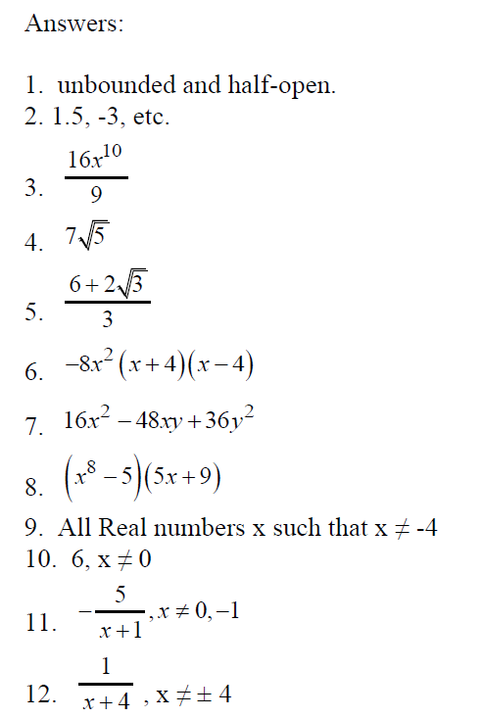
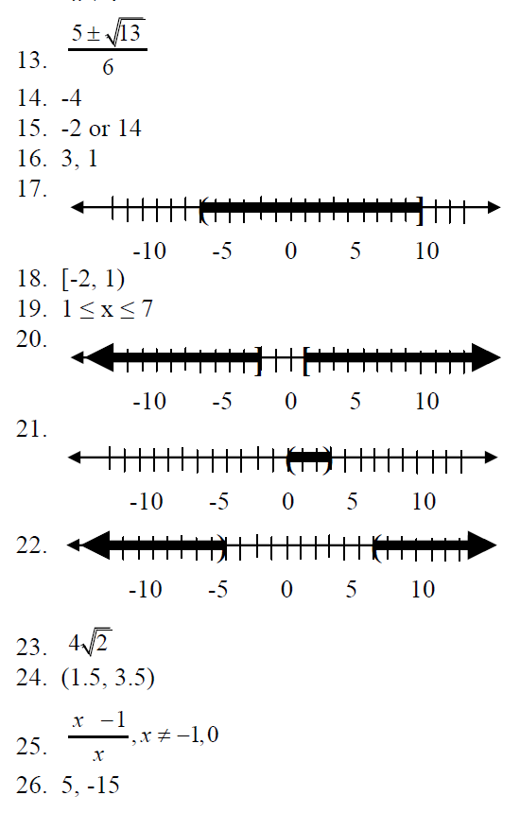

Slide 3
Objective:
Review for Chapter P Exam

Slide 4
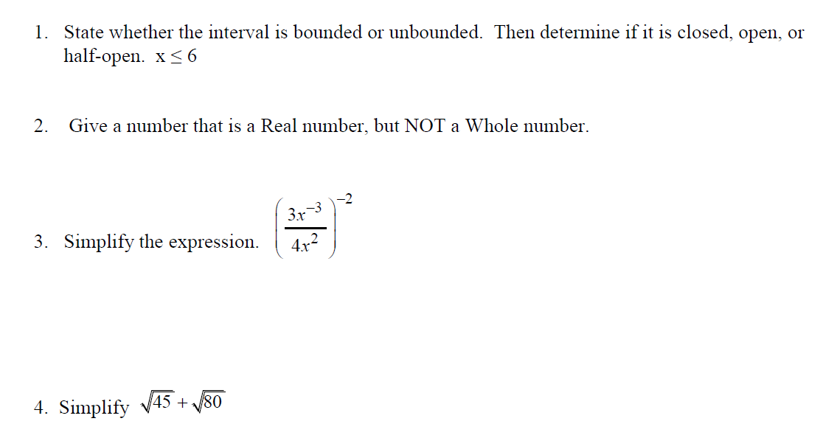

Slide 5
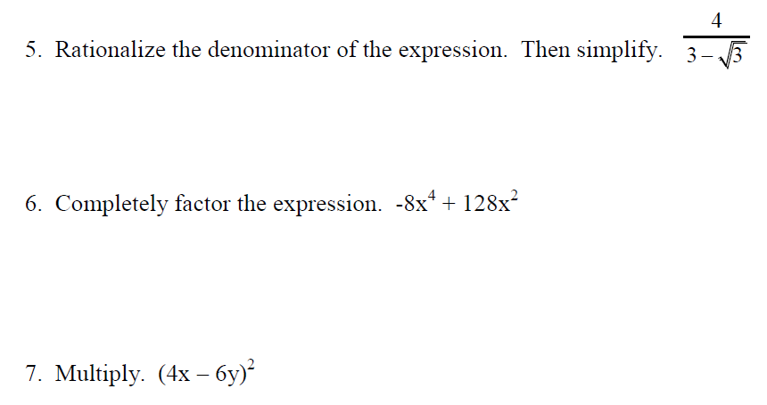

Slide 6
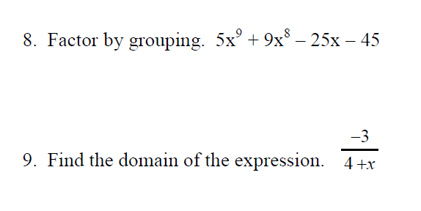

Slide 7
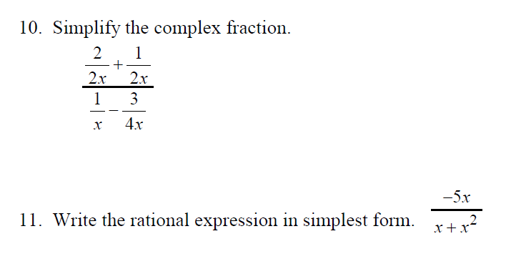

Slide 9
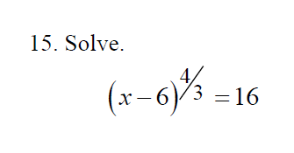
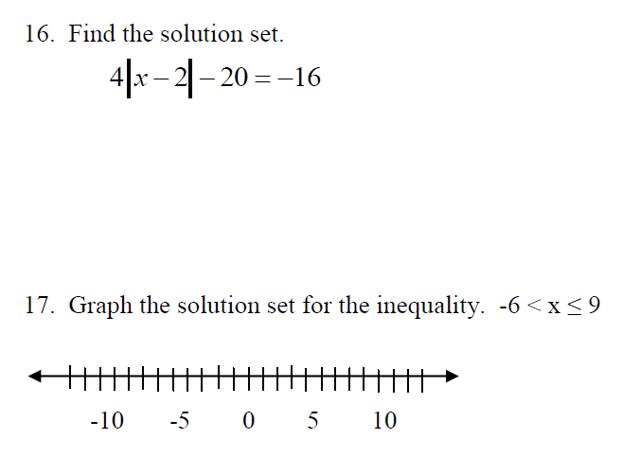

Slide 10
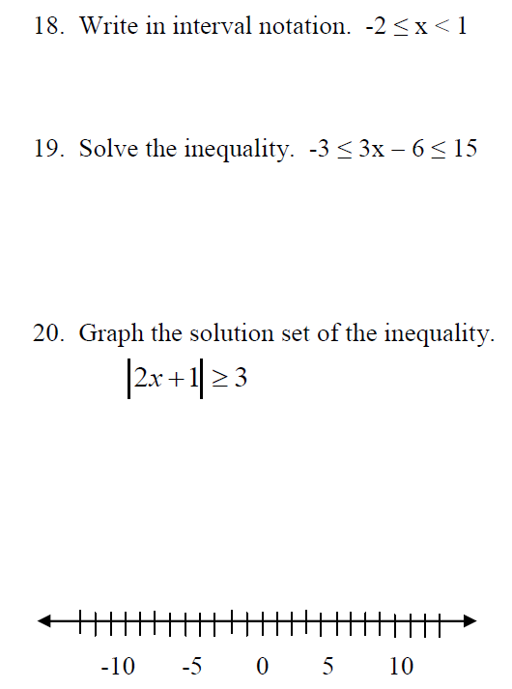

Slide 11
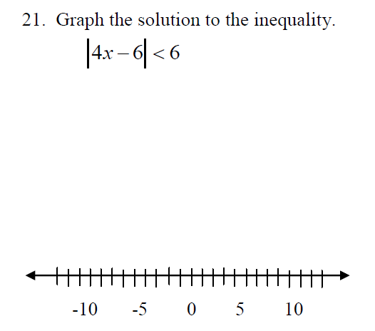
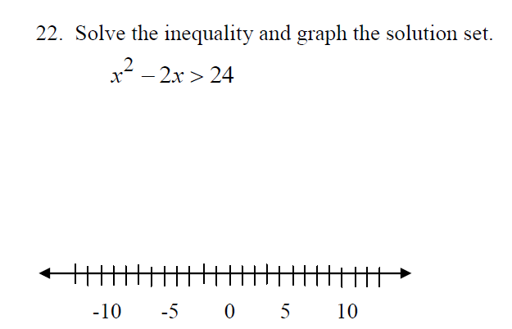

Slide 12
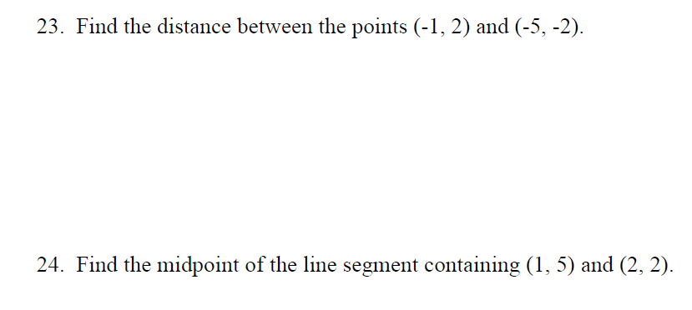

Slide 13
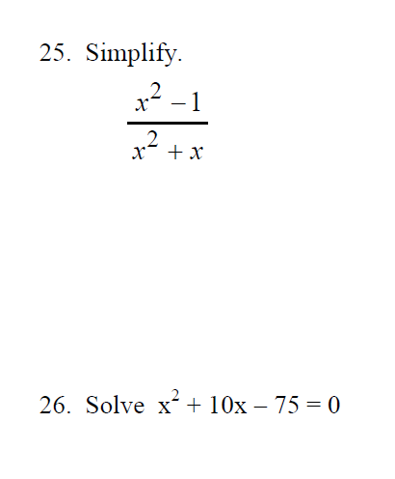

Slide 14
Summary:
Review for Chapter P Exam

Slide 15
Sneedlegrit:
Solve ${\left(x−3\right)}^{2/3}=16$
Homework:
Study for Chapter P Exam

