Slide 1
Warm-up:
For the following equation, give the required values and graph. For the shifts, give direction as well as units of translation. If there is no shift, then state none.
max__________
min__________
c. amplitude__________
d. fundamental period__________
e. vertical shift__________
f. horizontal shift__________
HW: pg410(2 – 14, 44 – 62, 70 – 76) EVENS!

Slide 2
4.5 GRAPHS OF
SINE AND COSINE FUNCTIONS
Objective:
Review
Graph sine and cosine functions
Find the amplitude and period of the sine and cosine function
Translations of sine and cosine functions

Slide 3
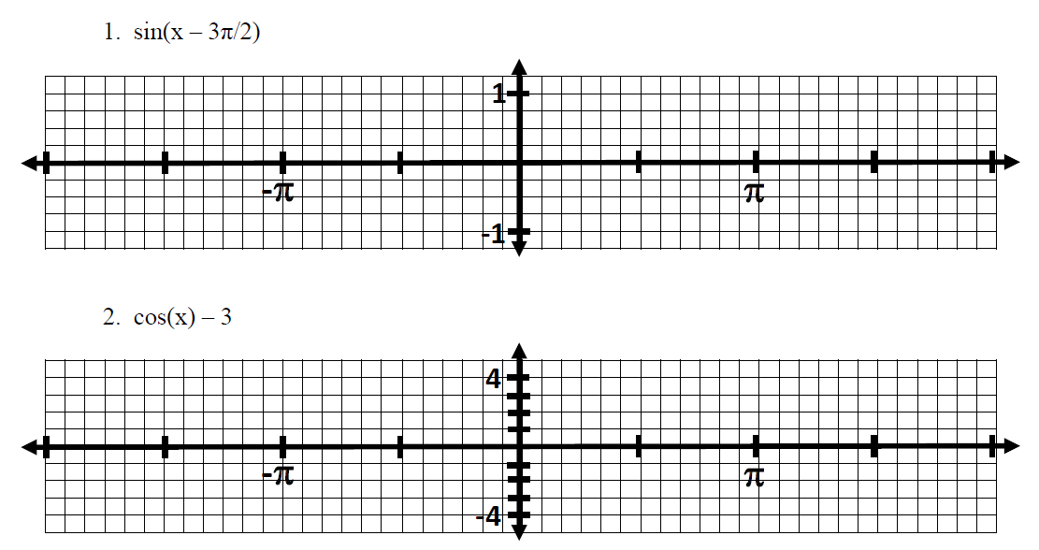

Slide 4
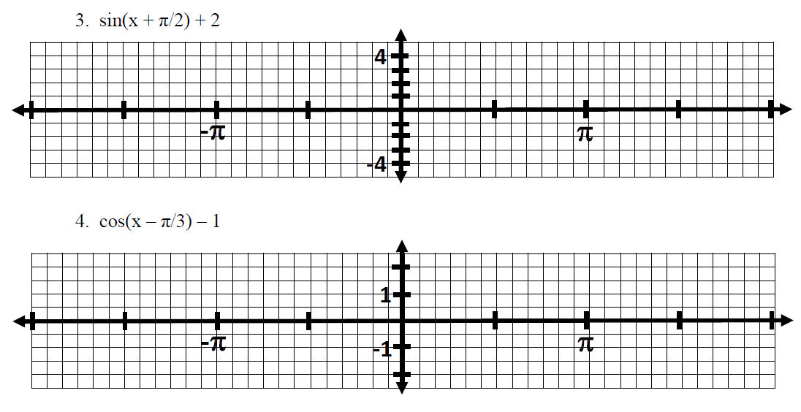

Slide 5
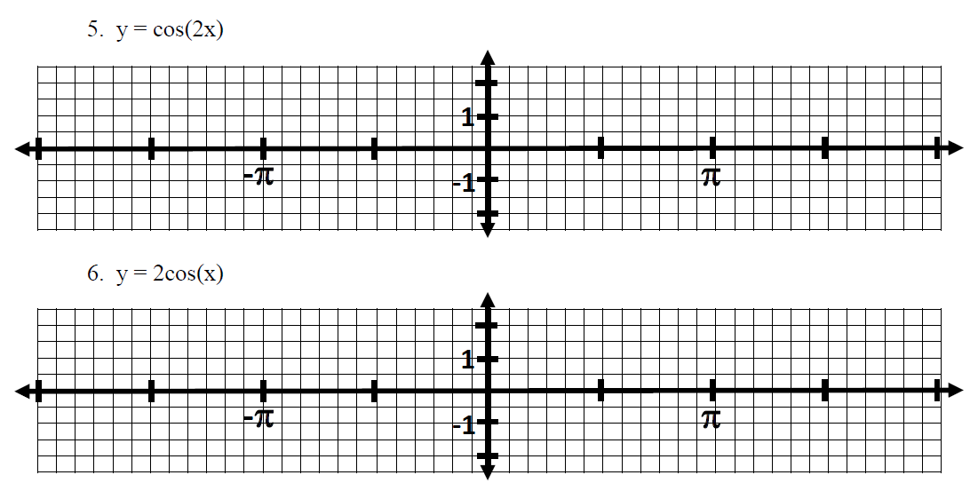

Slide 6
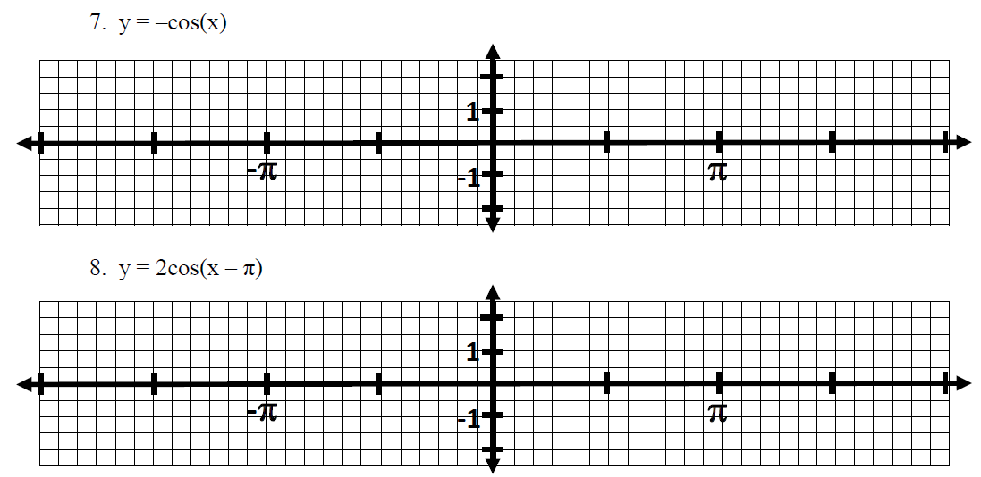

Slide 8
Sneedlegrit:
Graph from -2π to 2π. Remember the rules of graphing.
y = -cos(x + π/2) + 2
HW: pg410(2 – 14, 44 – 62, 70 – 76) EVENS!

