Slide 1
Warm-up:
For the following equation, give the required values and graph. For the shifts, give direction as well as units of translation. If there is no shift, then state none.
max__________
min__________
c. amplitude__________
d. fundamental period__________
e. vertical shift__________
f. horizontal shift__________
-π
π
HW: Practice Graphing Sine and Cosine Quiz

Slide 2
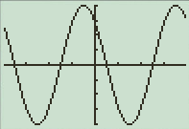
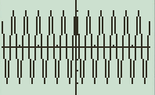
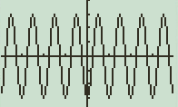
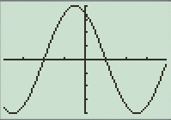
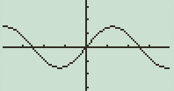
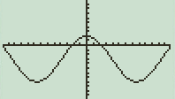
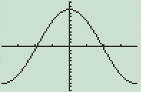
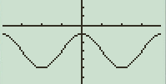
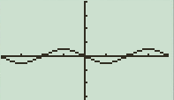
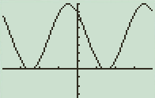

HW Answers: pg.410 – 412 (2 – 10, 44 – 62, 70 – 76)evens!
2) Pd: 2π/3 A: 2
4) Pd: 6π A: 3
6) Pd: 4 A: 3/2
8) Pd: 3π A: 1
10) Pd: π/4 A: 1/3
44) 52) 60)
46) 54) 62)
48) 56) 70) $y=−1+2cosx$
72) $y=−3−cosx$
50) 58) 74) $y=2sin\left(\frac{x}{2}\right)$
76) $y=2sin\left(\frac{πx}{2}+\frac{π}{2}\right)$

Slide 3
4.5 GRAPHS OF
SINE AND COSINE FUNCTIONS
Objective:
Review
Graph sine and cosine functions
Find the amplitude and period of the sine and cosine function
Translations of sine and cosine functions

Slide 4
Sneedlegrit:
Graph from -2π to 2π. Remember the rules of graphing.
y = sin(x + π/6) + 1
HW: Practice Graphing Sine and Cosine Quiz

