Slide 1
Warm-up:
Given a line with slope -3 and a point on the line (2, 1) find three more points on the line.
CW: Chapter 1 Review

Slide 2
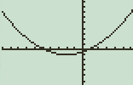
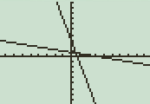
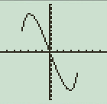
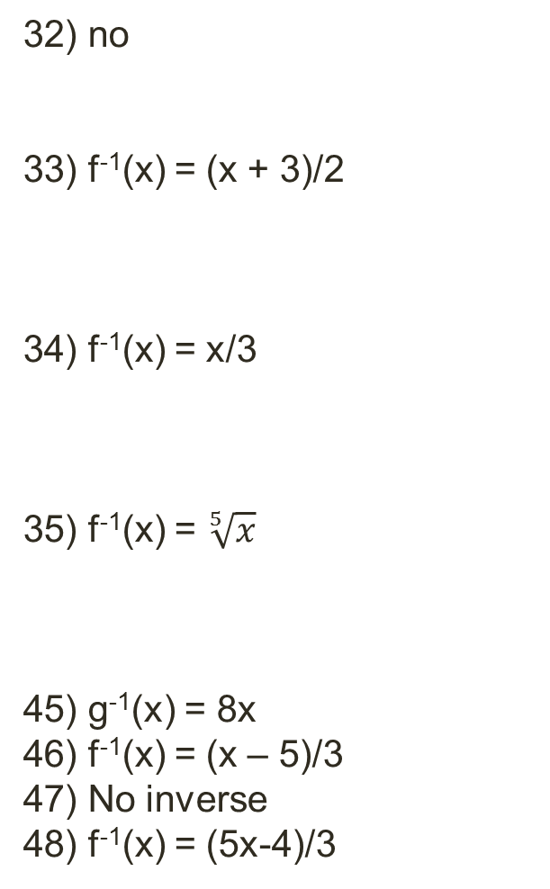
HW Answers: Page 181 (6, 7, 9, 13,14, 21-26 all, 31-32, 33 – 35 all, 45 – 48 all)
6) f⁻¹(x) = 5x
7) f⁻¹(x) = x - 10
9) f⁻¹(x) = x³
13) a. f(g(x)) = x, g(f(x) = x
b.
14) a. f(g(x)) = x, g(f(x) = x
b.
21) No
22) Yes
23) Yes
24) No
25) No
26) Yes
31) No
32) no
33) f⁻¹(x) = (x + 3)/2
34) f⁻¹(x) = x/3
35) f⁻¹(x) = $\sqrt[5]{x}$
45) g⁻¹(x) = 8x
46) f⁻¹(x) = (x – 5)/3
47) No inverse
48) f⁻¹(x) = (5x-4)/3

Slide 3
Chapter 1 Review
Objective:
Practice chapter 1 review problems

Slide 5
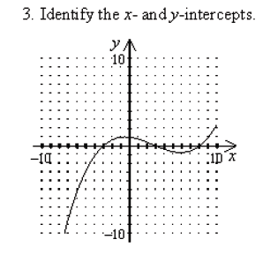
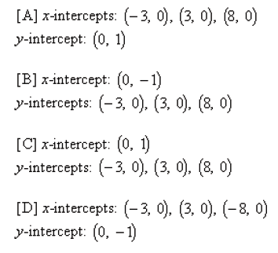

Slide 6
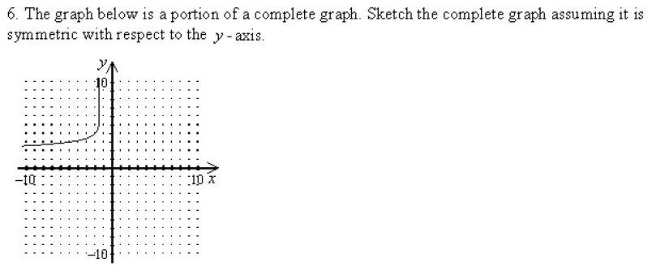

Slide 7
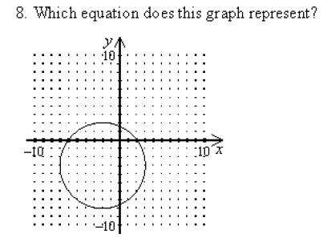

Slide 11
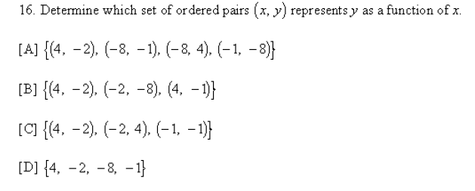

Slide 13
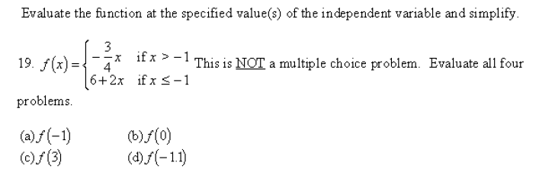

Slide 14
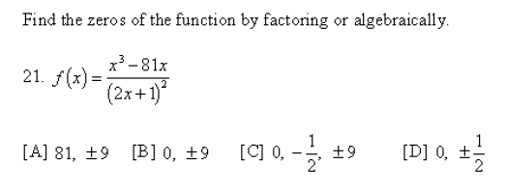

Slide 15
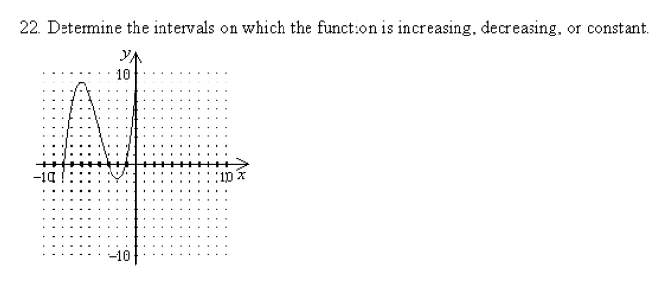
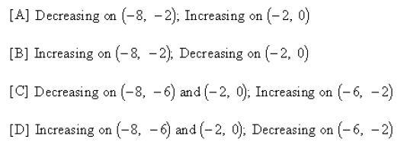
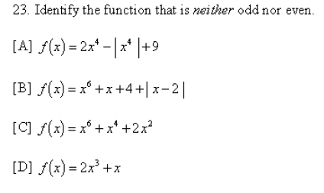

Slide 16
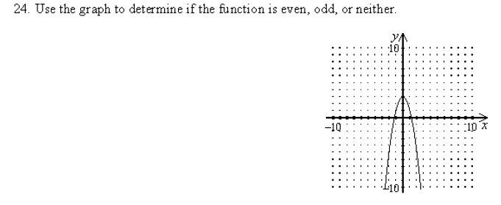

Slide 17
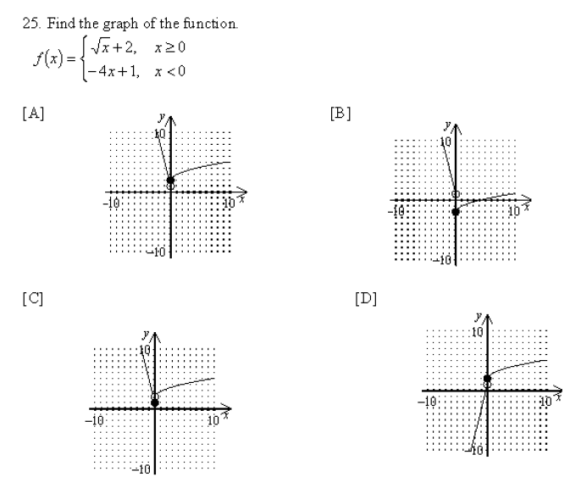

Slide 18
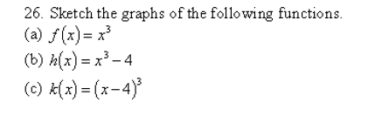

Slide 21
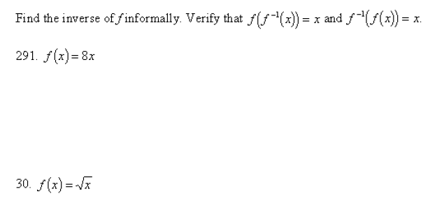

Slide 22
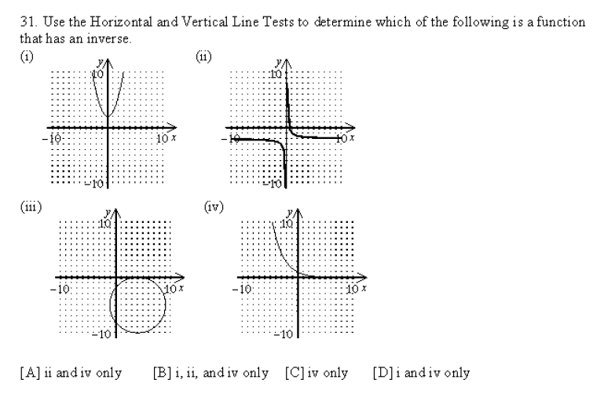

Slide 23
Summary:
Practice chapter 1 review problems

Slide 24
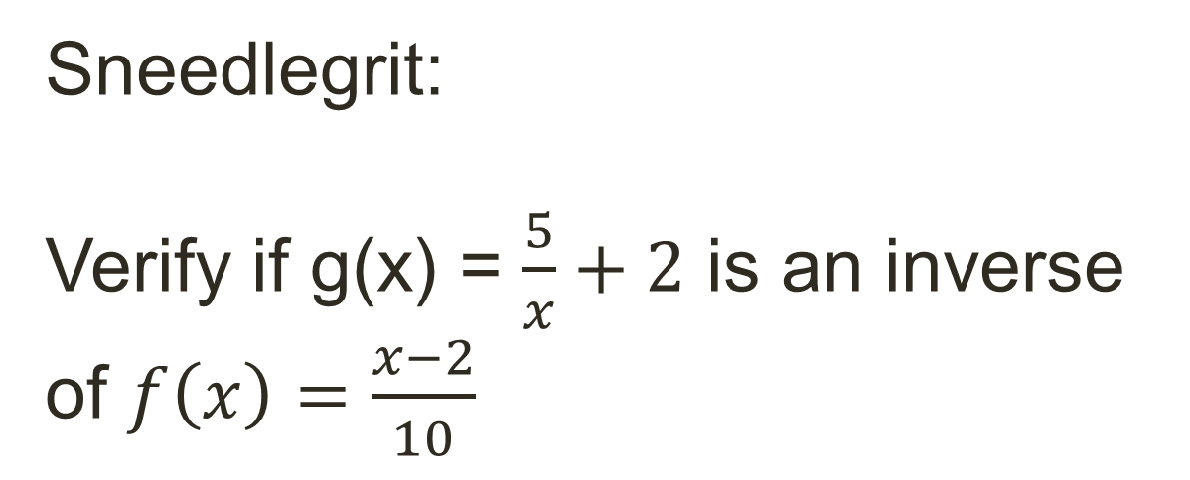
Sneedlegrit:
Verify if g(x) = $\frac{5}{x}+2$ is an inverse of $f\left(x\right)=\frac{x−2}{10}$
HW: Finish Chapter 1 Review Classwork

