Slide 1
Warm-up:
Find x-intercepts and y-intercepts. Determine symmetry type, if any.
f(x) = x³ - 2x² g(x) = x³ - 1 h(x) = x² - 1
HW: Study for Chapter 1 Exam

Slide 2
Chapter 1 Review
Objective:
Review 1.1 to 1.6 for a chapter exam

Slide 4
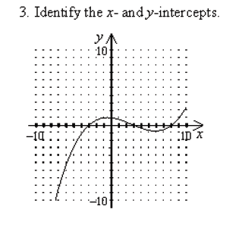
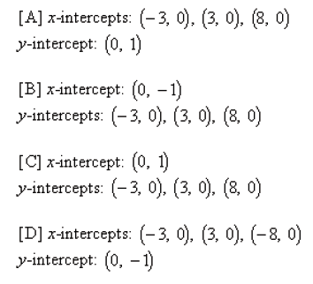

Slide 5
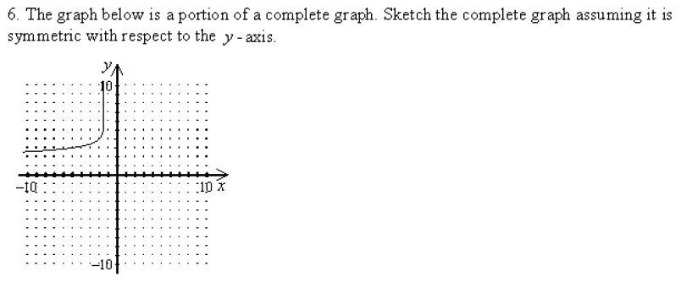

Slide 6
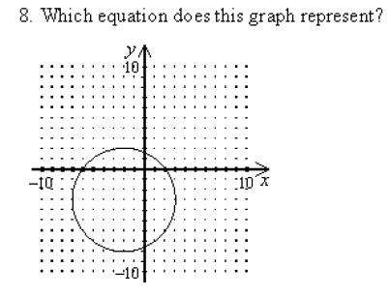

Slide 10
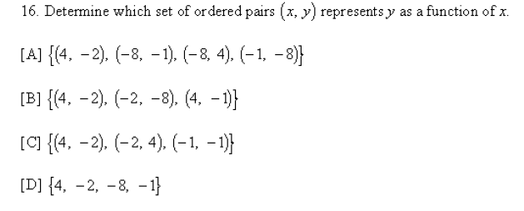

Slide 12
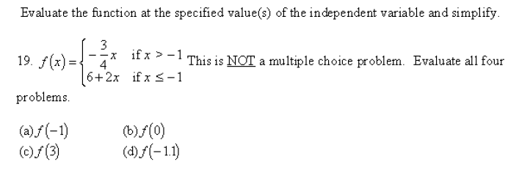

Slide 13
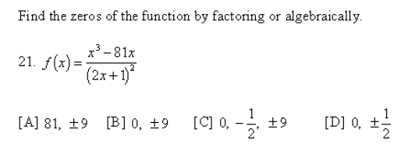

Slide 14
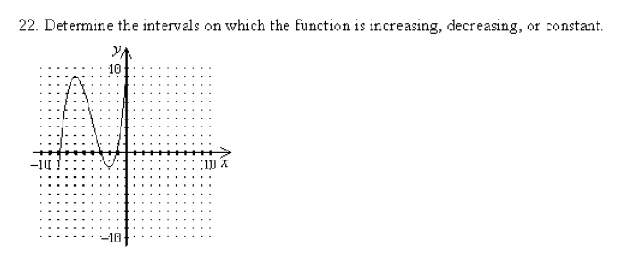
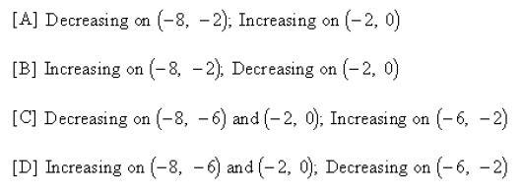
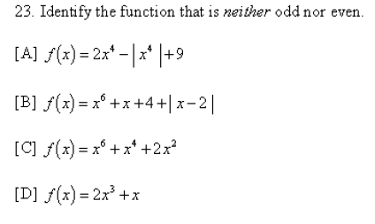

Slide 15
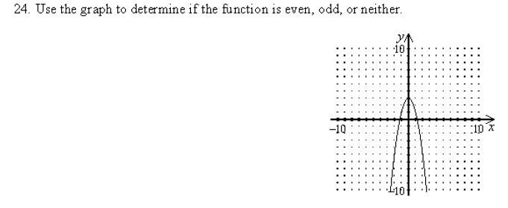

Slide 16
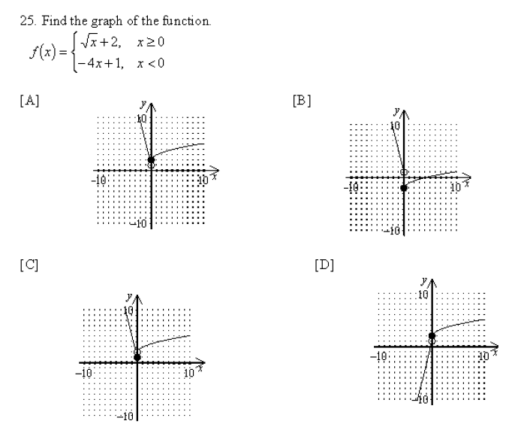

Slide 17
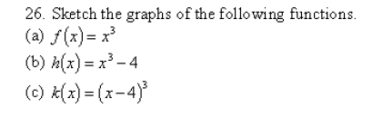

Slide 20
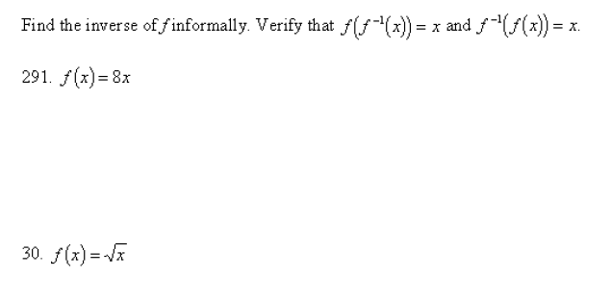

Slide 21
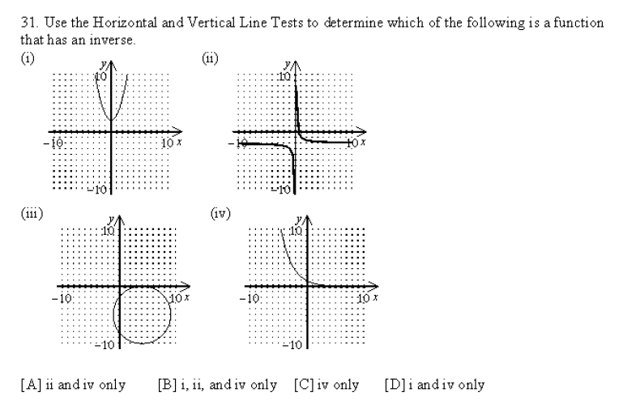

Slide 22
Summary:
Review 1.1 to 1.6 for a chapter exam

Slide 23
Sneedlegrit:
Given the following functions determine the domain and range.
a. f(x) = $\sqrt{x−3}$ b. f(x) = |x| – 4
HW: Study for Chapter 1 Exam

