Slide 1
Warm up:
Write an equation for the hyperbola with Foci at (2, 5), (2, -5) and vertices (2, 3), (2, -3)
HW2: Hyperbolas Worksheet

Slide 2
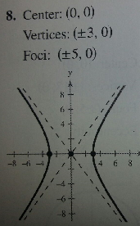
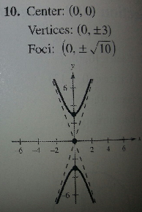
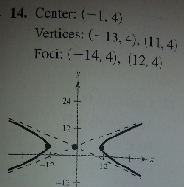
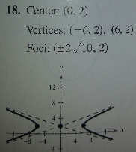
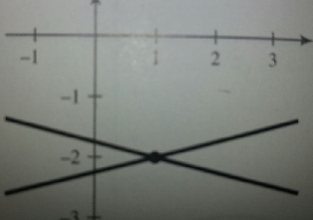
HW Answers: page 824 (1-6 all) page 824-825 (8, 10, 14, 18, 20, 28, 32, 36, 40)
B
C
E
D
A
F
20)
28) 36)
32) 40)

Slide 3
Sketch the hyperbola given by -x² + 4y² – 2x – 16y – 1 = 0
Sneedlegrit:
HW2: Hyperbolas Worksheet

